Slide 1
MEET US AT THE HORIZON
Diversity & Disability Fellow Capstone Project
By Jorrell Watkins

Slide 2
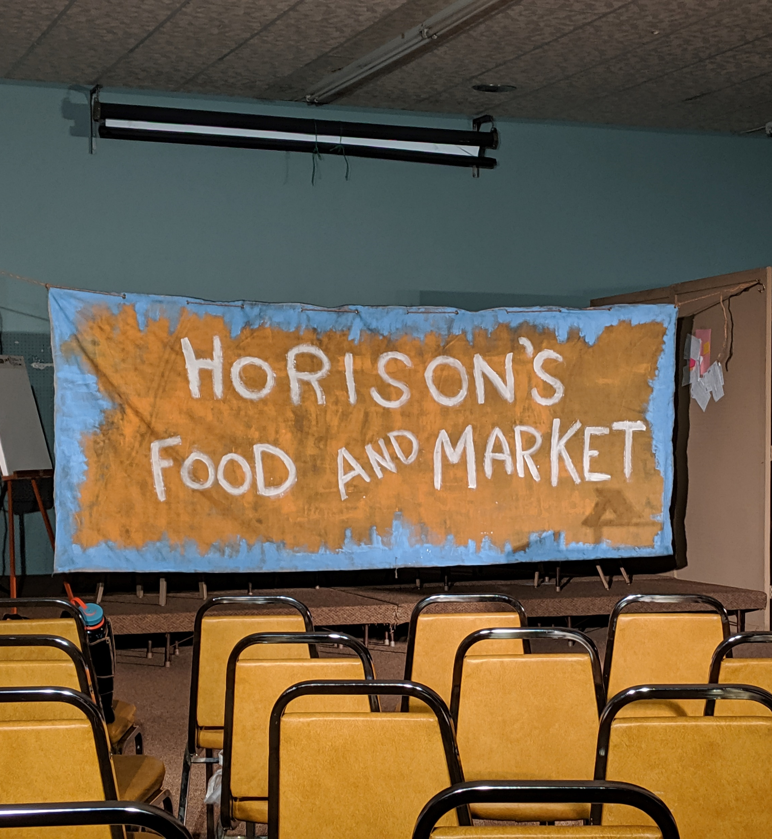
CAPSTONE PROJECT COMPONENTS
Research and fieldwork
Writing and development
Production*
Education/Public Dissemination
*Combined Efforts Theater Company, produced and directed this play for its world premiere.

Slide 3
RESEARCH & FIELDWORK
Meetings with Employment/ Transition Specialists
Judy Warth, Program Manager and Employment Specialist, CDD
John McCalley, and Blaine Beatty, Representatives of AmeriGroup Iowa
Training modules on Disability Studies
Fair Labor Standards Act of 1938 Section 14(c)
Field Experience
Disability Initiatives Forum at IC Public Library

Slide 4
RESEARCH & FIELDWORK
Fair Labor of Standards Act of 1938 Section 14(c)
“authorizes employers, after receiving a certificate from WHD, to pay wages that are less than the Federal minimum wage to workers who have disabilities for the work being performed.”¹
Americans with Disabilities Act 1990 Executive Order 13658 (2014) Workforce Innovation Opportunity Act (WIOA) (2014)
*WHD: US Wage and Hour Division

Slide 5
RESEARCH & FIELDWORK
Community Rehabilitation Programs (CRPS)
Employers of Patient Workers
School Work Experience Programs (SWEPS)
Business Certificate Holders

Slide 6
RESEARCH & FIELDWORK
Community Rehabilitation Programs: a program that provides directly or facilitates the provision of vocational rehabilitation services to individuals with disabilities, and that provides, singly or in combination, for an individual with a disability to enable the individual to maximize opportunities for employment, including career advancement.² The relationship of employed workers of disabilities is of a “Consumer.”

Slide 7
RESEARCH & FIELDWORK
Number of Employees Paid Subminimum Wage³
Crossroads Inc. of Muscatine, IA (92)
The ARC (2,094)*
Goodwill Industries (3,718)*
*these are nationwide figures reported to the US Department of Labor

Slide 8
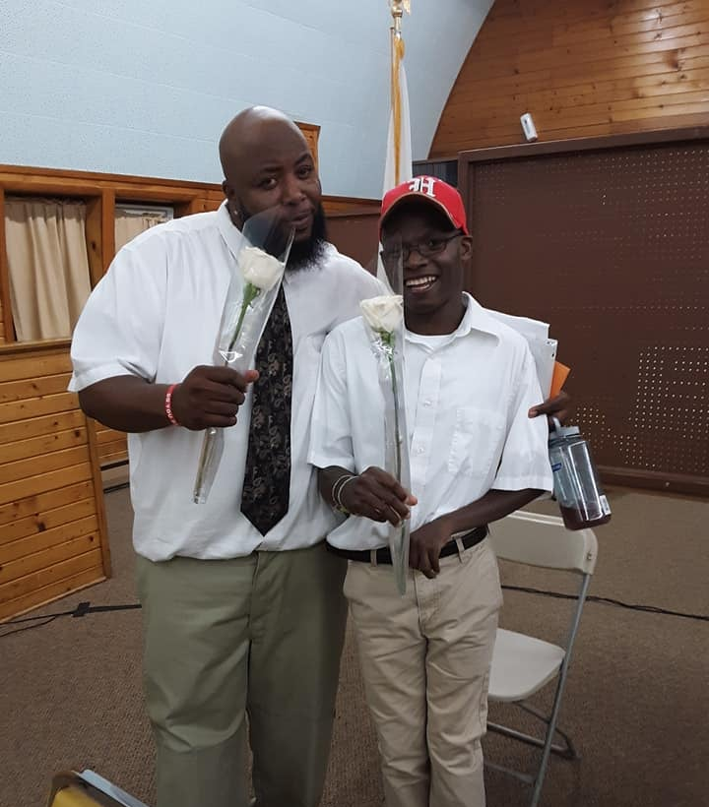
WRITING & DEVELOPMENT
Personal Experience Theater Arts and Workforce
Meeting Combined Efforts Theater Co. Janet Schlapkohl, Company Director and Founder⁴
Writing Disability Inclusive Theater
Working with Combined Efforts on casting and community outreach

Slide 9
PRODUCTION
Four shows over the weekend of Sept 27th to Sept 29th directed by Jason Grubbe
Audio Description Services provided for premiere
Over 230 Evaluation surveys completed

Slide 10
PRODUCTION
Question | Very Effective | Effective | Fairly Effective | Not Effective
How Effective was this play in increasing your knowledge about people with disabilities and employment in the community? | 57 | 49 | 8 | 1
 | Highly Satisfied | Satisfied | Somewhat Satisfied | Not Satisfied
What is your overall level of satisfaction with this play? | 79 | 35 | 5 | 0

Slide 11
PRODUCTION
92%
Very & Somewhat
Effective
95%
Very & Satisfied

Slide 12
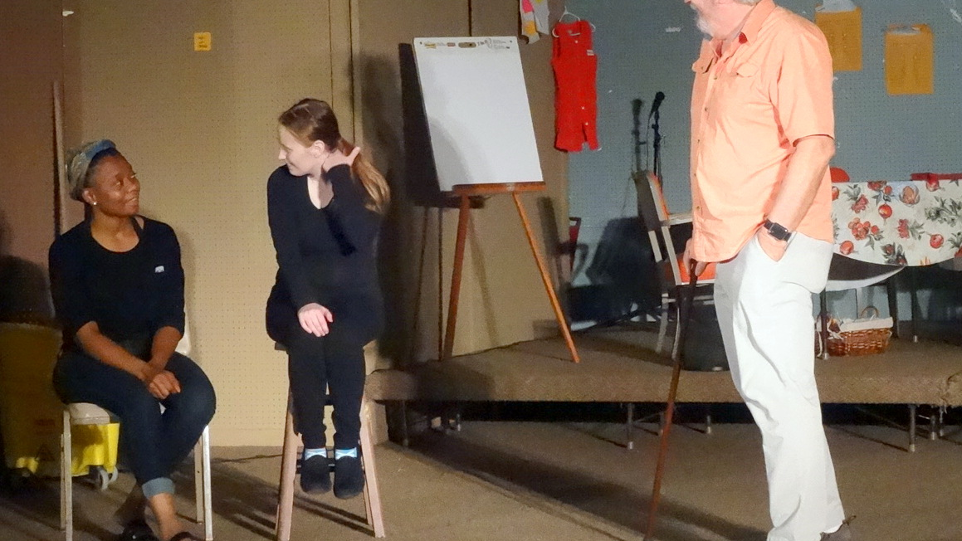
PRODUCTION
Comments from attendees
“I think the subject is a tough one - a lot of people are experiencing job loss under similar circumstances. Given the constraints of a play format, this was done very well.”
“Having a good food source in a community is very important. [I’m] Always for the underdog in their fight against bias corporations.”
“Great play even if some of the actors were able bodied. Great presentation of the info [for] those who don’t work in the field, but live in the community might not realize.”

Slide 13
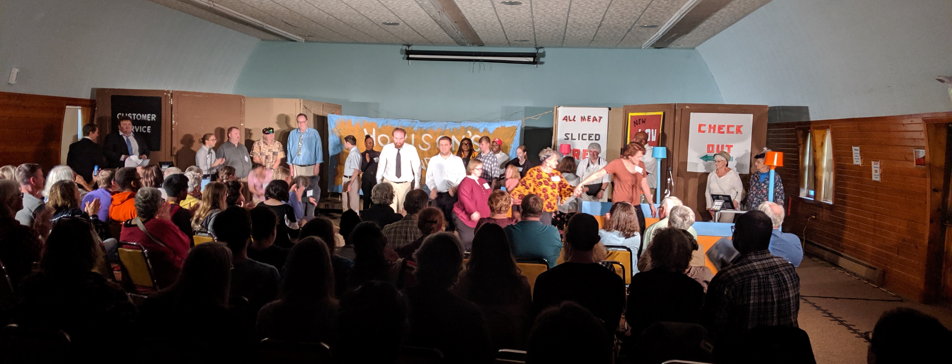
EDUCATION & PUBLIC DISSEMINATION
Video recording of the Combined Efforts Theater Co. production available on AUCD website
Script available on the AUCD Website
Discussion guide

Slide 14
FINAL TAKEAWAYS
CDD collaboration with Combined Efforts Theater Company.
Community redefined, reinterpreted (people, and place)
Development of multicultural-responsive Disability Inclusive Arts

Slide 15
NOTES
“About Workers With Disabilities - U.S. Department of Labor — Wage and Hour Division (WHD).” n.d. Accessed October 20, 2019. https://www.dol.gov/whd/workerswithdisabilities/about.htm.
“Community Rehabilitation Program Law and Legal Definition | USLegal, Inc.” n.d. Accessed October 15, 2019. https://definitions.uslegal.com/c/community-rehabilitation-program/.
As of July, 2019. See the U.S. Department of Labor site for full list. “About Workers With Disabilities - U.S. Department of Labor — Wage and Hour Division (WHD).” n.d. Accessed October 20, 2019. https://www.dol.gov/whd/workerswithdisabilities/about.htm.
“Combined Efforts Theatre - Iowa City-Performing Arts.” Accessed October 20, 2019. https://combinedefforts.org/.

